Slide 1
Five Components of Effective Mathematics Intervention

Slide 2
srpowell@austin.utexas.edu
@sarahpowellphd
119

Slide 3
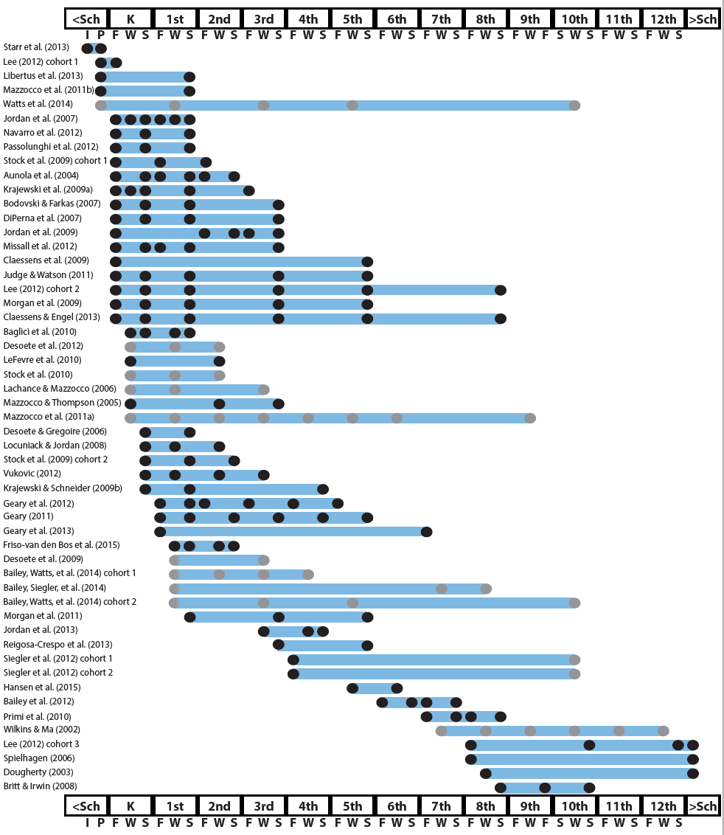
http://www.greatertexasfoundation.org/trajectories-of-mathematics-performance/

Slide 4
Broad math in preK predicted K broad math
Mathematics in preschool predicts later mathematics
http://www.greatertexasfoundation.org/trajectories-of-mathematics-performance/
Broad math in preK predicted grade 10 broad math

Slide 5
Counting in K predicted grade 1 broad math
Mathematics in kindergarten predicts later mathematics
http://www.greatertexasfoundation.org/trajectories-of-mathematics-performance/
Broad math in K predicted grade 8 broad math
K math accurately predicted math performance below 10th percentile in grades 2 and 3 with 84% correct classification

Slide 6
Mathematics in elementary school
predicts later mathematics
Addition influenced arithmetic with increasing importance from grades 1 to 5
http://www.greatertexasfoundation.org/trajectories-of-mathematics-performance/
Grade 1 arithmetic predicted arithmetic at grades 2, 3, and 4
Grade 1 broad math predicted broad math at grades 3, 5, and 10

Slide 7
Mathematics in middle school
predicts later mathematics
Counting and comparison in grades 2 or 4 predicted broad math 1 year later
http://www.greatertexasfoundation.org/trajectories-of-mathematics-performance/
Fractions at 10-12 years old predicted broad math 5 years later
Broad math in grade 7 predicted broad math in grade 8

Slide 8
Broad math in grade 8 predicted completion of 4-year college degree
Mathematics in
high school
predicts later outcomes
http://www.greatertexasfoundation.org/trajectories-of-mathematics-performance/
Students who took algebra in grades 8 took more advanced math courses and enrolled in 4-year colleges more often than students who took algebra in grade 9
Numeracy measured in adolescence impacted hourly earnings 7 to 15 years later

Slide 9
Mathematics in preschool predicts later mathematics
Mathematics in kindergarten predicts later mathematics
http://www.greatertexasfoundation.org/trajectories-of-mathematics-performance/
Mathematics in elementary school
predicts later mathematics
Mathematics in middle school
predicts later mathematics
Mathematics in
high school
predicts later outcomes

Slide 10
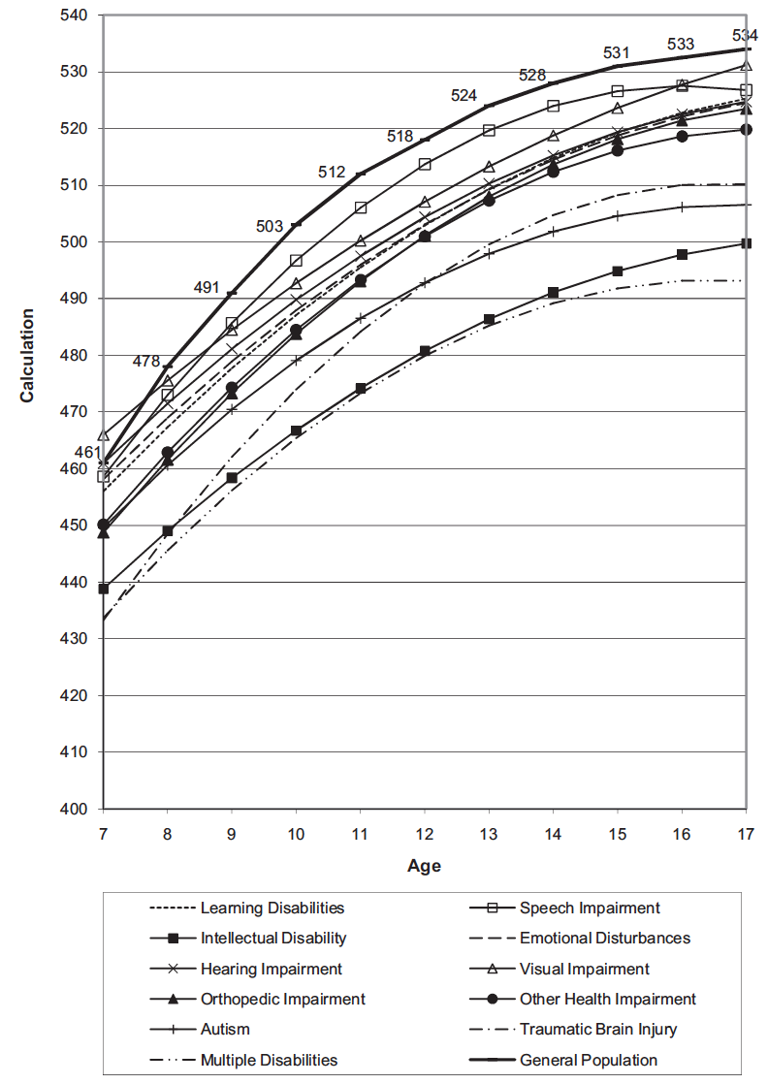
Wei, Lenz, & Blackorby (2013)

Slide 11
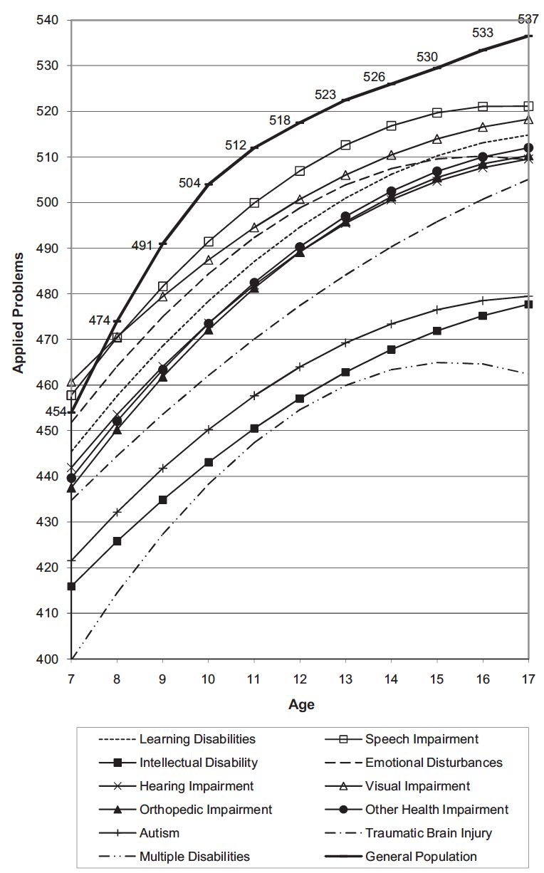
Wei, Lenz, & Blackorby (2013)

Slide 12
Descriptors of mathematics difficulty
Mathematics difficulty/disability
Mathematics learning difficulty/disability
Specific learning disability with IEP goals in mathematics
Dyscalculia

Slide 13
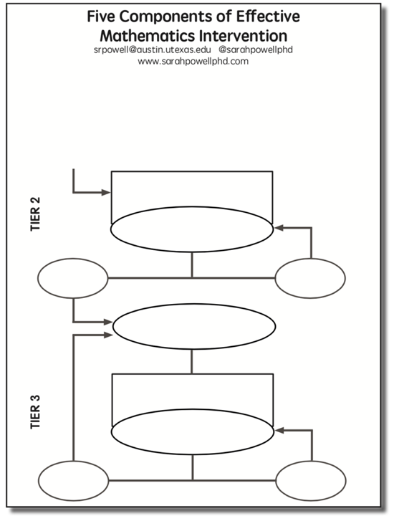

Slide 14
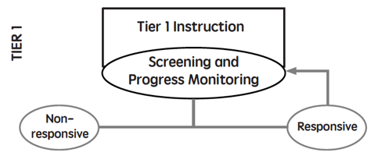
Core instruction utilizes evidence-based practices
All students screened (universal screener)
Students scoring below a cut-score are suspected at risk for math difficulties
Suspected at-risk students monitored for 6 to 10 weeks during primary prevention using progress monitoring

Slide 15
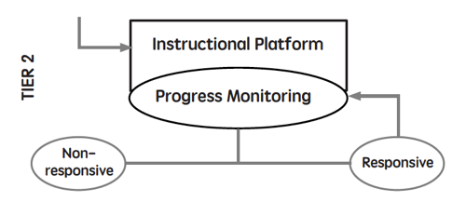
Students are tutored in small groups using evidence-based practices
Tutoring takes place three or four times a week
Each tutoring session lasts 30 to 60 minutes
Tutoring lasts 10 to 20 weeks
Progress monitoring continues weekly

Slide 16
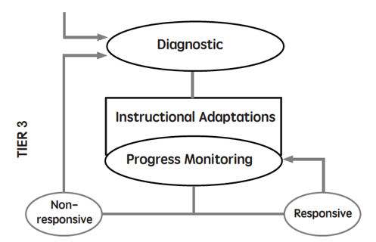
Diagnostics are conducted
Adaptations are made to the student’s intervention
Student progress is monitored weekly
With adequate slopes or end levels, students return to Tier 1 or 2

Slide 17
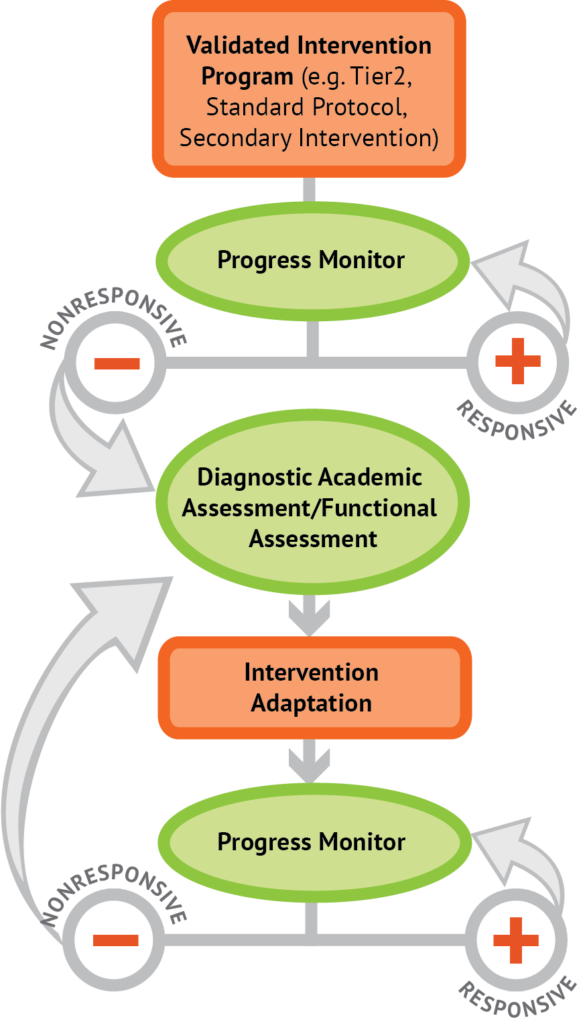
Intervention: Occurs frequently and with intensity
Assessment: Formative
Assessment: Diagnostic
Intervention adaptation: Content, dosage, explicit instruction, attention to transfer
Assessment: Formative

Slide 18
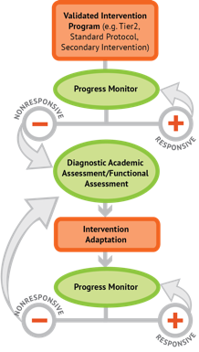
Where student IS
Where student NEEDS TO BE

Slide 19
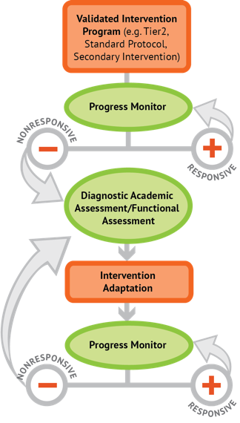
Instructional Platform
INSTRUCTIONAL DELIVERY
Explicit instruction
Precise language
Multiple representations
INSTRUCTIONAL STRATEGIES
Fluency building
Problem solving instruction

Slide 20
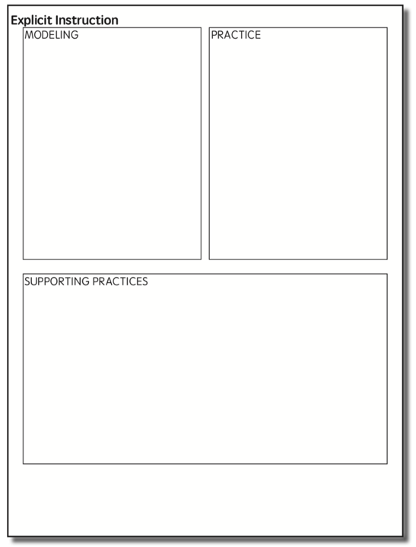

Slide 21
Modeling
Practice
Clear Explanation
Guided
Practice
Planned
Examples
Independent Practice
Supporting Practices
Asking the right questions
Eliciting frequent responses
Providing immediate specific feedback
Maintaining a brisk pace

Slide 22
Goal and importance
“Today, we are learning about division. This is important because sometimes you have to share objects or things with your friends.”
Modeling
Practice
Clear Explanation
Guided
Practice
We Do
Planned
Examples
Independent Practice
“Let’s continue working with our three-dimensional shapes and volume. Understanding volume and calculating volume helps with measuring capacity.”
You Do
Supporting Practices
Asking the right questions
Eliciting frequent responses
Providing immediate specific feedback
Maintaining a brisk pace
Copyright 2018 Sarah R. Powell, Ph.D.

Slide 23
Goal and importance
Model steps
Modeling
Practice
Clear Explanation
Guided
Practice
“To solve 26 plus 79, I first decide about the operation. Do I add, subtract, multiply or divide?”
We Do
Planned
Examples
Independent Practice
“The plus sign tells me to add. So, I’ll add 26 plus 79. I’ll use the partial sums strategy. First, I add 20 plus 70. What’s 20 plus 70?”
You Do
Supporting Practices
“20 plus 70 is 90. I write 90 right here.”
Asking the right questions
Eliciting frequent responses
Providing immediate specific feedback
Maintaining a brisk pace
“Then I add 6 plus 9. What’s 6 plus 9?”
“6 plus 9 is 15. So, I write 15 here.”
“Finally, we add the partial sums: 90 and 15. 90 plus 15 is 105. So, 26 plus 79 equals 105.”
Copyright 2018 Sarah R. Powell, Ph.D.

Slide 24
Goal and importance
Model steps
Modeling
Practice
Clear Explanation
Precise language
Guided
Practice
We Do
Planned
Examples
Independent Practice
“To solve 26 plus 79, I first decide about the operation. Do I add, subtract, multiply, or divide?”
You Do
“The plus sign tells me to add. So, I’ll add 26 plus 79. I’ll use the partial sums strategy. First, I add 20 plus 70. What’s 20 plus 70?”
Supporting Practices
Asking the right questions
Eliciting frequent responses
Providing immediate specific feedback
Maintaining a brisk pace
“20 plus 70 is 90. I write 90 right here under the equal line.”
“Then I add 6 plus 9. What’s 6 plus 9?”
“6 plus 9 is 15. So, I write 15 here.”
“Finally, we add the partial sums: 90 and 15. 90 plus 15 is 105. So, 26 plus 79 equals 105.”
Copyright 2018 Sarah R. Powell, Ph.D.

Slide 25
Examples
“Today, we are learning about division. This is important because sometimes you have to share objects or things with your friends.”
Modeling
Practice
Clear Explanation
Guided
Practice
24 / 6
We Do
35 $)$ 5
28 $÷$ 7
Planned
Examples
Independent Practice
You Do
Supporting Practices
Asking the right questions
Eliciting frequent responses
Providing immediate specific feedback
Maintaining a brisk pace
Copyright 2018 Sarah R. Powell, Ph.D.

Slide 26
Examples
“Today, we are learning about division. This is important because sometimes you have to share objects or things with your friends.”
Modeling
Practice
Clear Explanation
Guided
Practice
24 / 6
We Do
35 $)$ 5
28 $÷$ 7
Planned
Examples
Independent Practice
You Do
With non-examples
Supporting Practices
Asking the right questions
Eliciting frequent responses
Providing immediate specific feedback
Maintaining a brisk pace
32 $÷$ 8
42 $÷$ 7
25 $−$ 5
Copyright 2018 Sarah R. Powell, Ph.D.

Slide 27
Modeling
Practice
Clear Explanation
Guided
Practice
Planned
Examples
Independent Practice
Supporting Practices
Asking the right questions
Eliciting frequent responses
Providing immediate specific feedback
Maintaining a brisk pace
Copyright 2018 Sarah R. Powell, Ph.D.

Slide 28
I Do
Modeling
Practice
Clear Explanation
Guided
Practice
Planned
Examples
Independent Practice
Supporting Practices
Asking the right questions
Eliciting frequent responses
Providing immediate specific feedback
Maintaining a brisk pace
Copyright 2018 Sarah R. Powell, Ph.D.

Slide 29
I Do
Modeling
Practice
Teacher and student practice together
Clear Explanation
Guided
Practice
Planned
Examples
Independent Practice
Supporting Practices
Asking the right questions
Eliciting frequent responses
Providing immediate specific feedback
Maintaining a brisk pace
Copyright 2018 Sarah R. Powell, Ph.D.

Slide 30
I Do
Modeling
Practice
Clear Explanation
Guided
Practice
Planned
Examples
Independent Practice
Student practices with teacher support
Supporting Practices
Asking the right questions
Eliciting frequent responses
Providing immediate specific feedback
Maintaining a brisk pace
Copyright 2018 Sarah R. Powell, Ph.D.

Slide 31
Modeling
Practice
Clear Explanation
Guided
Practice
Planned
Examples
Independent Practice
Supporting Practices
Asking the right questions
Eliciting frequent responses
Providing immediate specific feedback
Maintaining a brisk pace
Copyright 2018 Sarah R. Powell, Ph.D.

Slide 32
I Do
Modeling
Practice
Clear Explanation
Guided
Practice
We Do
Planned
Examples
Independent Practice
You Do
Supporting Practices
Asking the right questions
Eliciting frequent responses
Providing immediate specific feedback
Maintaining a brisk pace
Copyright 2018 Sarah R. Powell, Ph.D.

Slide 33
I Do
Modeling
Practice
Clear Explanation
Guided
Practice
Low-level and high-level
We Do
Planned
Examples
Independent Practice
You Do
“What is 7 times 9?”
“Which shape has 6 sides?”
“What do you do when you see a word problem?”
“Why do you have to regroup?”
“How would you solve this problem?”
“Why do you have to use zero pairs?”
Supporting Practices
Asking the right questions
Eliciting frequent responses
Providing immediate specific feedback
Maintaining a brisk pace
Copyright 2018 Sarah R. Powell, Ph.D.

Slide 34
I Do
Modeling
Practice
Clear Explanation
Guided
Practice
Low-level and high-level
We Do
Planned
Examples
Independent Practice
You Do
Classwide, individual, partner, write on paper, write on whiteboard, thumbs up, etc.
“Turn and discuss the formula for perimeter with your partner.”
“Write the multiplication problem on your whiteboard.”
Supporting Practices
Asking the right questions
Eliciting frequent responses
Providing immediate specific feedback
Maintaining a brisk pace
“In your math journal, draw a picture to help you remember to term parallelogram.”
Copyright 2018 Sarah R. Powell, Ph.D.

Slide 35
I Do
Modeling
Practice
Clear Explanation
Guided
Practice
Low-level and high-level
We Do
Planned
Examples
Independent Practice
You Do
Classwide, individual, partner, write on paper, write on whiteboard, thumbs up, etc.
Affirmative and corrective
Supporting Practices
“Good work using your word-problem attack strategy.”
Asking the right questions
Eliciting frequent responses
Providing immediate specific feedback
Maintaining a brisk pace
“Let’s look at that again. Tell me how you added in the hundreds column.”
Copyright 2018 Sarah R. Powell, Ph.D.

Slide 36
I Do
Modeling
Practice
Clear Explanation
Guided
Practice
Low-level and high-level
We Do
Planned
Examples
Independent Practice
You Do
Classwide, individual, partner, write on paper, write on whiteboard, thumbs up, etc.
Affirmative and corrective
Planned and organized
Supporting Practices
Asking the right questions
Eliciting frequent responses
Providing immediate specific feedback
Maintaining a brisk pace
Copyright 2018 Sarah R. Powell, Ph.D.

Slide 37
Modeling
Practice
Clear Explanation
Guided
Practice
Planned
Examples
Independent Practice
Supporting Practices
Asking the right questions
Eliciting frequent responses
Providing immediate specific feedback
Maintaining a brisk pace
Copyright 2018 Sarah R. Powell, Ph.D.

Slide 38
Modeling
Practice
Supporting Practices
Introduction of material
Review of material
Modeling
Practice
Modeling
Practice
Supporting Practices
Supporting Practices

Slide 39
How do you use explicit instruction?
Model steps using concise language
Provide guided practice opportunities
Provide independent practice opportunities
Use supporting practices during modeling and practice
Ask the right questions
Elicit frequent responses
Provide feedback
Be planned and organized

Slide 40
Instructional Platform
INSTRUCTIONAL DELIVERY
Explicit instruction
Precise language
INSTRUCTIONAL STRATEGIES

Slide 41
degree

Slide 42
Vocabulary Across Grades

Slide 43
The Language of Mathematics
Listening
Speaking
Reading
Writing
Vocabulary

Slide 45
Categories of Difficulty
1. Some math terms are shared with English but have different meanings
right
base
degree
Rubenstein & Thompson (2002)

Slide 46
1. Some math terms are shared with English but have different meanings
2. Some math words are shared with English with similar meanings
(but a more precise math meaning)
difference
even
Rubenstein & Thompson (2002)

Slide 47
1. Some math terms are shared with English but have different meanings
2. Some math words are shared with English with similar meanings
(but a more precise math meaning)
3. Some math terms are only used in math
numerator
trapezoid
parallelogram
Rubenstein & Thompson (2002)

Slide 48
1. Some math terms are shared with English but have different meanings
2. Some math words are shared with English with similar meanings
(but a more precise math meaning)
3. Some math terms are only used in math
4. Some math terms have more than one meaning
square
round
base
second
Rubenstein & Thompson (2002)

Slide 49
1. Some math terms are shared with English but have different meanings
2. Some math words are shared with English with similar meanings
(but a more precise math meaning)
3. Some math terms are only used in math
4. Some math terms have more than one meaning
5. Some math terms are similar to other content-area terms with different meanings
divide vs. Continental Divide
variable vs. variably cloudy
Rubenstein & Thompson (2002)

Slide 50
1. Some math terms are shared with English but have different meanings
2. Some math words are shared with English with similar meanings
(but a more precise math meaning)
3. Some math terms are only used in math
4. Some math terms have more than one meaning
5. Some math terms are similar to other content-area terms with different meanings
6. Some math terms are homographs
sum vs. some
eight vs. ate
base vs. bass
rows vs. rose
Rubenstein & Thompson (2002)

Slide 51
1. Some math terms are shared with English but have different meanings
2. Some math words are shared with English with similar meanings
(but a more precise math meaning)
3. Some math terms are only used in math
4. Some math terms have more than one meaning
5. Some math terms are similar to other content-area terms with different meanings
6. Some math terms are homographs
7. Some math terms are related but have distinct meanings
hundreds vs. hundredths
factor vs. multiple
numerators vs. denominator
Rubenstein & Thompson (2002)

Slide 52
1. Some math terms are shared with English but have different meanings
2. Some math words are shared with English with similar meanings
(but a more precise math meaning)
3. Some math terms are only used in math
4. Some math terms have more than one meaning
5. Some math terms are similar to other content-area terms with different meanings
6. Some math terms are homographs
7. Some math terms are related but have distinct meanings
8. An English math term may translate into another language with different meanings
mesa vs. tabla
Rubenstein & Thompson (2002)

Slide 53
1. Some math terms are shared with English but have different meanings
2. Some math words are shared with English with similar meanings
(but a more precise math meaning)
3. Some math terms are only used in math
4. Some math terms have more than one meaning
5. Some math terms are similar to other content-area terms with different meanings
6. Some math terms are homographs
7. Some math terms are related but have distinct meanings
8. An English math term may translate into another language with different meanings
four vs. forty
9. English spelling and usage may have irregularities
Rubenstein & Thompson (2002)

Slide 54
1. Some math terms are shared with English but have different meanings
2. Some math words are shared with English with similar meanings
(but a more precise math meaning)
3. Some math terms are only used in math
4. Some math terms have more than one meaning
5. Some math terms are similar to other content-area terms with different meanings
6. Some math terms are homographs
7. Some math terms are related but have distinct meanings
8. An English math term may translate into another language with different meanings
9. English spelling and usage may have irregularities
skip count vs. multiples
10. Some math concepts are verbalized in more than one way
one-fourth vs. one quarter

Slide 55
1. Some math terms are shared with English but have different meanings
2. Some math words are shared with English with similar meanings
(but a more precise math meaning)
3. Some math terms are only used in math
4. Some math terms have more than one meaning
5. Some math terms are similar to other content-area terms with different meanings
6. Some math terms are homographs
7. Some math terms are related but have distinct meanings
8. An English math term may translate into another language with different meanings
9. English spelling and usage may have irregularities
10. Some math concepts are verbalized in more than one way
vertex vs. corner
rhombus vs. diamond
11. Informal terms may be used for formal math terms

Slide 56
Use formal math language
Use terms precisely

Slide 57
http://journals.sagepub.com/doi/full/10.1177/0040059916654901

Slide 74
How do you use mathematical language?
Use formal mathematical language
Define terms precisely
Engage students in explicit opportunities to learn mathematics vocabulary

Slide 75
Instructional Platform
INSTRUCTIONAL DELIVERY
Explicit instruction
Precise language
Multiple representations
INSTRUCTIONAL STRATEGIES

Slide 76
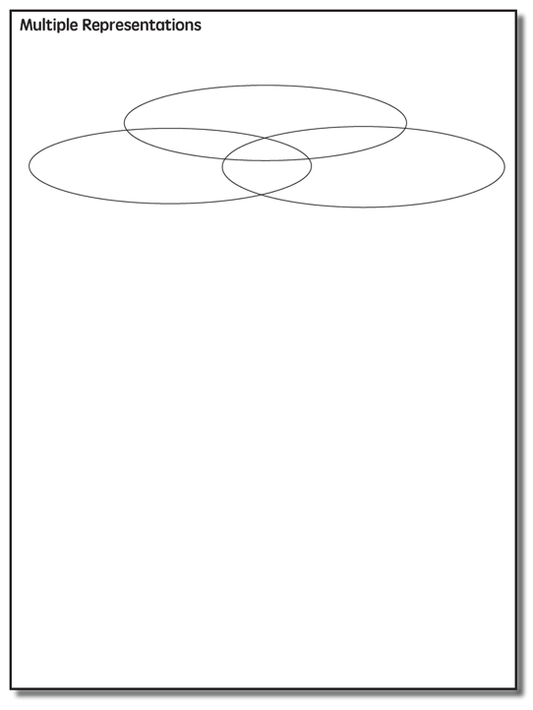

Slide 77
Multiple Representations
Abstract
Pictorial
Concrete

Slide 78
Abstract
Pictorial
Concrete
Three-dimensional objects

Slide 79
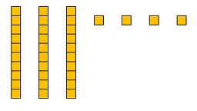
Abstract
Pictorial
Concrete
Two-dimensional images

Slide 80
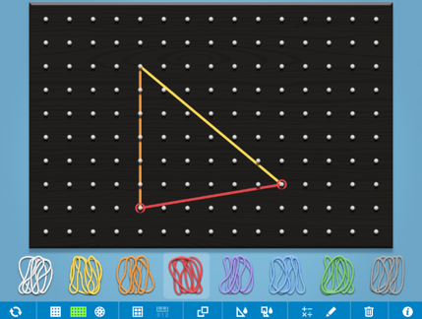
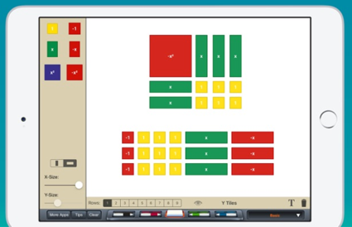
Abstract
Pictorial
Concrete
Two-dimensional images

Slide 81
Abstract
Pictorial
Concrete
Numerals and symbols
2 + 8 = 10
34 = 3 tens and 4 ones
x – 6 = 8
4,179
+ 569

Slide 82
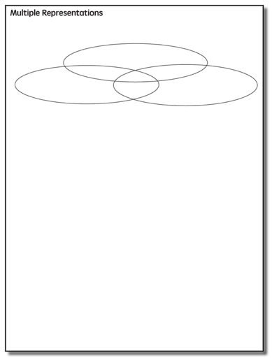
How do you use multiple representations?
Use concrete materials to teach concepts and procedures
Use pictorial representations to teach concepts and procedures
Ensure students understand mathematics with numbers and symbols and words (i.e., the abstract)

Slide 83
Examples of Multiple Representations

Slide 84
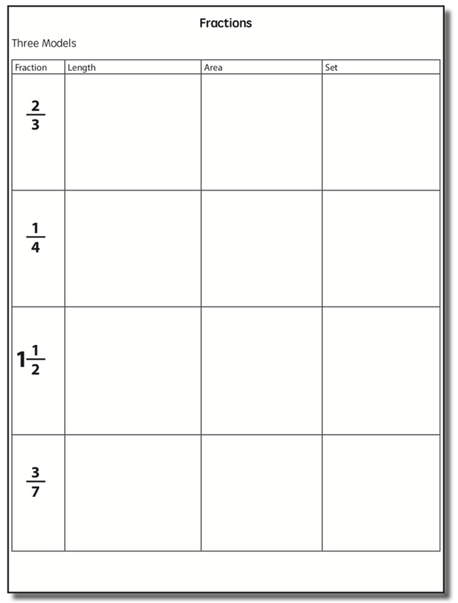

Slide 85
Fraction Models
Length
Area
Set

Slide 86
Length/Measurement
Fractions are appropriated by length
Cuisenaire rods

Slide 87
Area/Region
Shapes divided into equal sections
Geoboards

Slide 88
Set/Discrete
Individual shapes match the fraction
Two-color counters

Slide 89
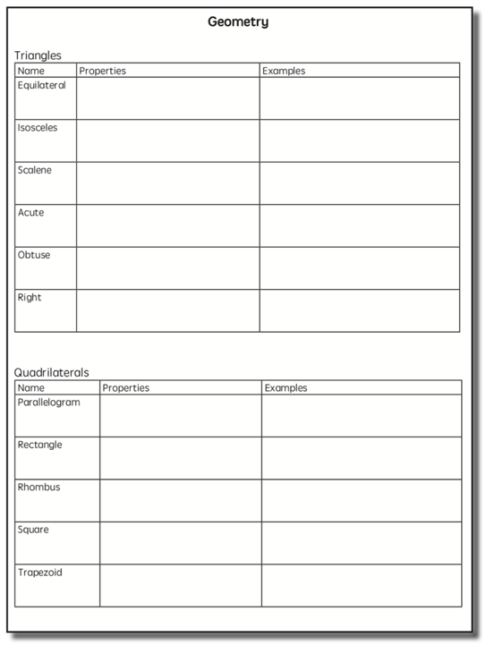

Slide 90
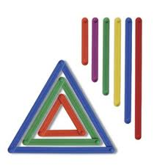
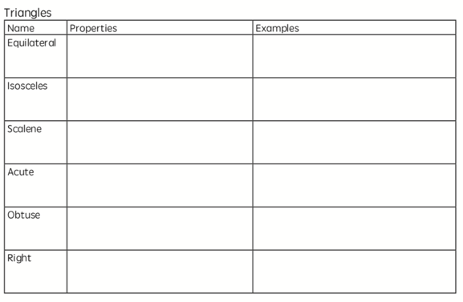
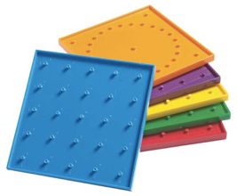
Triangles
Property of a triangle
A closed figure with 3 line segments and 3 angles
Anglegs
Geoboards

Slide 91
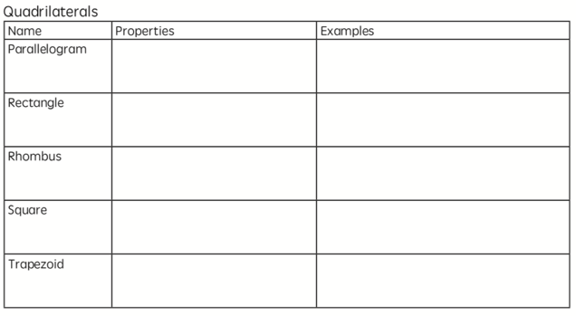
Quadrilaterals
Property of a quadrilateral
A closed figure with 4 line segments
Anglegs
Geoboards

Slide 92
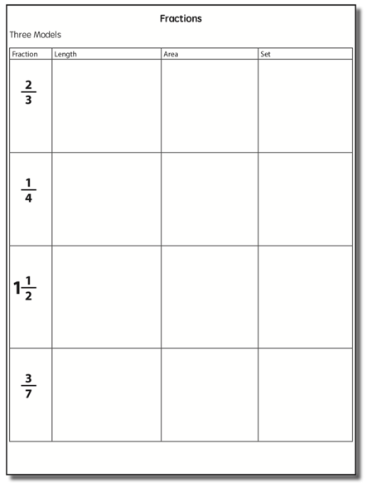

Slide 93
Instructional Platform
INSTRUCTIONAL DELIVERY
Explicit instruction
Precise language
Multiple representations
INSTRUCTIONAL STRATEGIES
Fluency building

Slide 95
Addition Facts
100 addition basic facts
Single-digit addends sum to a single- or double-digit number
5 (addend)
+ 4 (addend)
9 (sum)

Slide 96
Addition: Part-Part-Whole (Total)
Count one set, count another set, put sets together, count sum
2 + 3 = 5

Slide 97
Addition: Join (Change Increase)
Start with a set, add the other set, count sum
2 + 3 = 5

Slide 98
Why is it important to understand addition in two separate ways?

Slide 99
Total
Parts put together into a total
Angie saw 4 cardinals and 5 blue jays. How many birds did Angie see?
4 + 5 = ?

Slide 100
Change
An amount that increases or decreases
Pam had $4. Then she earned $3 for cleaning her room. How much money does Pam have now?
4 + 3 = ?

Slide 101
Part-Part-Whole Versus Join
3 + 9 = __
7 + 4 = __

Slide 102
Subtraction Facts
100 subtraction basic facts
Subtrahend and difference are single-digit numbers and minuend is single- or double-digit number
16 (minuend)
– 8 (subtrahend)
8 (difference)

Slide 103
Subtraction: Separate (Change Decrease)
Start with a set, take away from that set, count difference
5 – 3 = 2

Slide 104
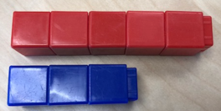
Subtraction: Compare (Difference)
Compare two sets, count difference
5 – 3 = 2

Slide 105
Why is it important to understand subtraction in two separate ways?

Slide 106
Change
An amount that increases or decreases
Amanda had 9 cookies. Then she ate 2 of the cookies. How many cookies does Amanda have now?
9 – 2 = ?

Slide 107
Difference
Greater and less amounts compared for a difference
Scott has 9 apples. Cathy has 4 apples. How many more apples does Scott have? (How many fewer does Cathy have?)
9 – 4 = ?

Slide 108
Separate Versus Compare
9 – 5 = __
8 – 3 = __

Slide 110
Addition and Subtraction
Introduce regrouping/trading/exchanging after mastery of problems without regrouping
10 ones for 1 ten
10 tens for 1 hundred
1 ten for 10 ones
1 hundred for 10 tens
Regroup
Trade
Exchange
Carry
Addition
Regroup
Trade
Exchange
Borrow
Subtraction

Slide 111
Autumn
Traditional
Work right to left (start in ones column)

Slide 112
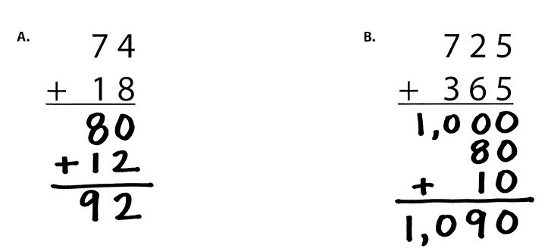
Lydia
Partial Sums
Work left to right

Slide 113
Victoria
Opposite Change
Round one number to nearest ten
Amount added is subtracted from other number

Slide 114
Carol
Column Addition
Work left to right

Slide 116
Julie
Traditional Method
Work right to left (start in ones column)

Slide 117
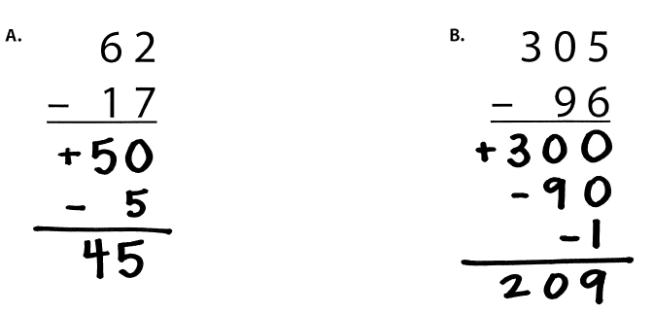
Janie
Partial Differences
Work left to right

Slide 118
Eric
Same Change
Change subtrahend to end in 0

Slide 119
Beth
Add-Up

Slide 121
Multiplication Facts
100 multiplication basic facts
Multiplication of single-digit factors results in a single- or double-digit product
2 (factor)
× 3 (factor)
6 (product)

Slide 122
Multiplication: Equal Groups
Show the groups, show the amount for each group, count product
3 × 2 = 6

Slide 123
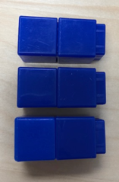
Multiplication: Array/Area
Make the array, count product
3 × 2 = 6

Slide 124
Multiplication: Comparison
Show a set, then multiply the set
3 × 2 = 6

Slide 125
Why is it important to understand multiplication in different ways?

Slide 126
Equal Groups
Groups multiplied by number in each group for a product
Carlos has 2 bags of apples. There are 6 apples in each bag. How many apples does Carlos have altogether?
2 × 6 = ?

Slide 127
Comparison
Set multiplied by a number of times for a product
Beth picked 6 apples. Amy picked 2 times as many apples as Beth. How many apples did Amy pick?
6 × 2 = ?

Slide 128
Equal Groups versus Comparison
6 × 3 = __
4 × 5 = __

Slide 129
Division Facts
90 division basic facts
Divisor and quotient are single-digit numbers and dividend is single- or double-digit number
8 ÷ 4 = 2
(dividend) (divisor) (quotient)

Slide 130
Division: Equal Groups (Partitive Division)
Show the dividend, divide equally among divisor, count quotient
6 ÷ 3 = 2

Slide 131
Division: Equal Groups (Measurement Division)
Show the dividend, make groups of the divisor, count groups
6 ÷ 3 = 2

Slide 132
Why is it important to understand division in different ways?

Slide 133
Equal Groups
Groups multiplied by number in each group for a product
Carlos has 12 apples. He wants to share them equally among his 2 friends. How many apples will each friend receive?
2 × ? = 12
Carlos has 12 apples. He put them into bags containing 6 apples each. How many bags did Carlos use?
? × 6 = 12

Slide 134
Partitive versus Measurement
10 ÷ 5 = __
9 ÷ 3 = __

Slide 136
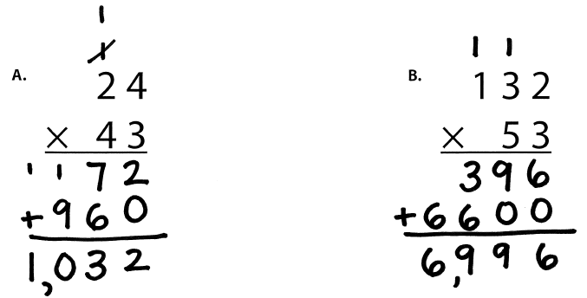
Angie
Traditional
Work right to left (start in ones column)

Slide 137
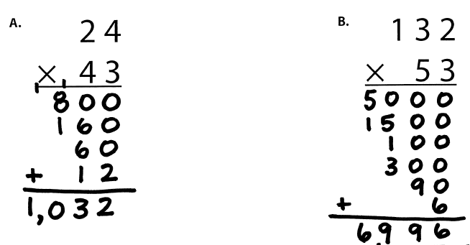
Carlos
Partial Products

Slide 138
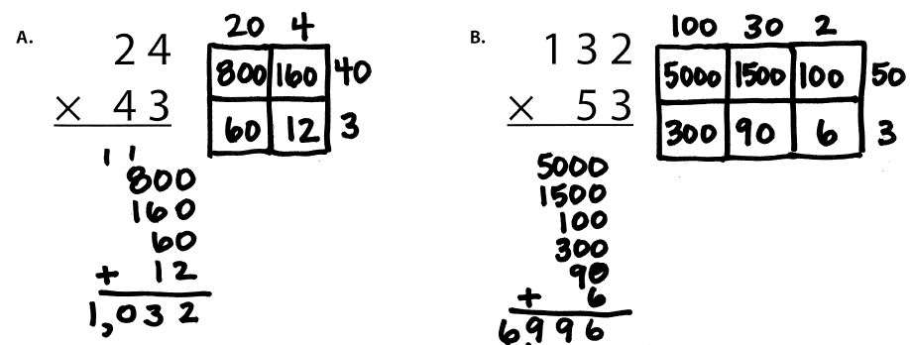
Cathy
Area

Slide 139
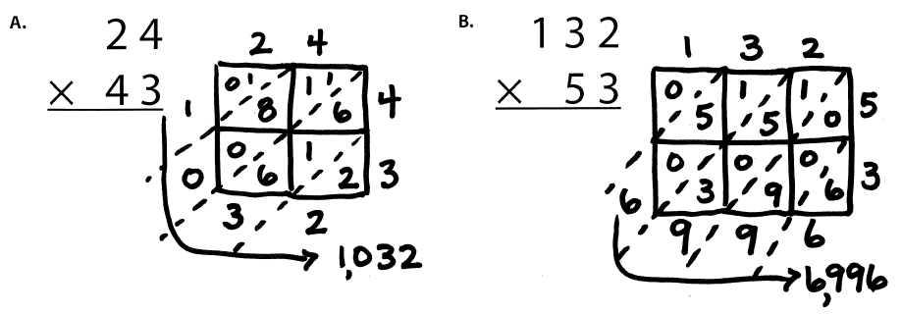
Scott
Lattice Method (383 × 27)

Slide 141
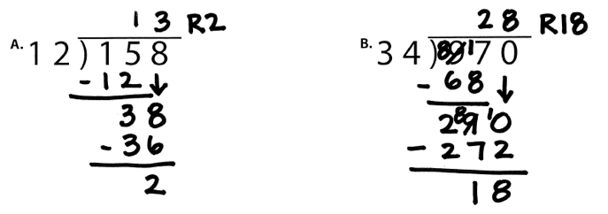
Pam
Traditional Method
Work Left to Right
Notes:
1. Yellow handouts: Multiplication and division

Slide 142
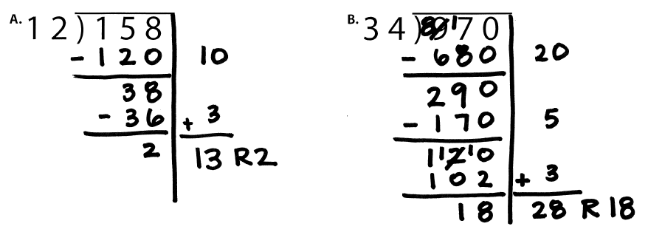
Amanda
Partial Quotients

Slide 143
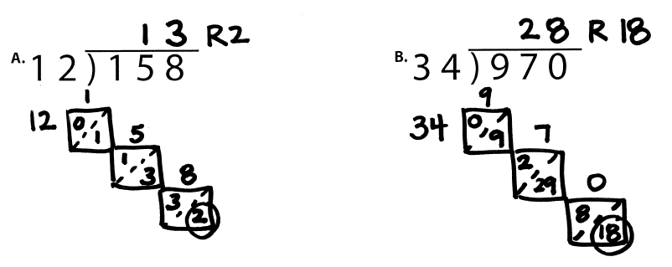
Julie
Lattice Division

Slide 144
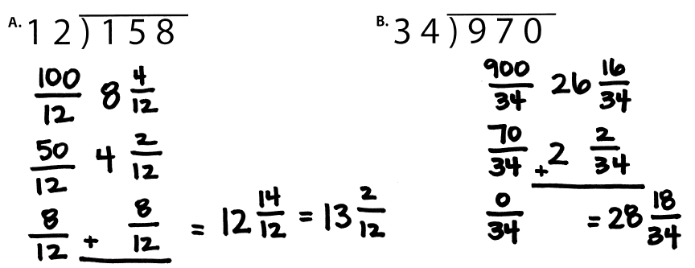
Janie
Division as Fractions

Slide 145
Addition
Subtraction
Multiplication
Division
BRIEF
(1-2 min)
DAILY
(everyday)

Slide 146
How to build fluency?
Teach the concepts of the operations
Teach strategies to understand how facts fit together
Practice building fluency with a variety of activities and games
Also focus on computational efficiency

Slide 147
Instructional Platform
INSTRUCTIONAL DELIVERY
Explicit instruction
Precise language
Multiple representations
INSTRUCTIONAL STRATEGIES
Fluency building
Problem solving instruction

Slide 148
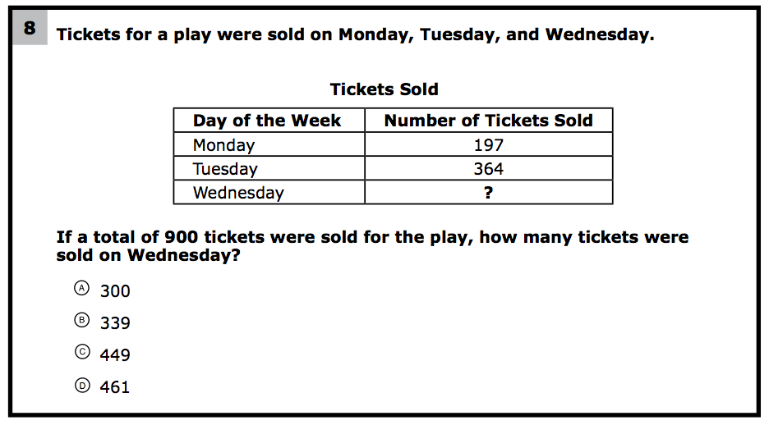
How would you teach this problem?
What do students need to know to solve this problem?
What might cause difficulty for students?

Slide 149
Problem Solving Difficulties
Reading problems
Understanding vocabulary
Identifying relevant information
Ignoring irrelevant information
Interpreting charts and graphs
Identifying appropriate operation(s)
Performing the computation(s)

Slide 151
Don’t tie key words to operations
Do have an attack strategy
Do teach word-problem schemas

Slide 152
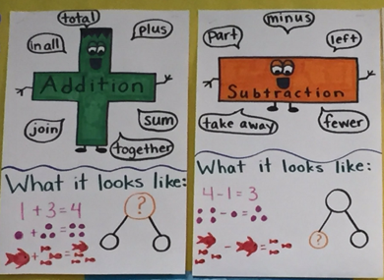
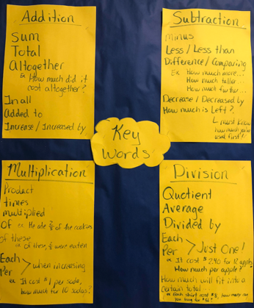

Slide 154
Students need to understand key words. But, key words should not be directly tied to operations.

Slide 155
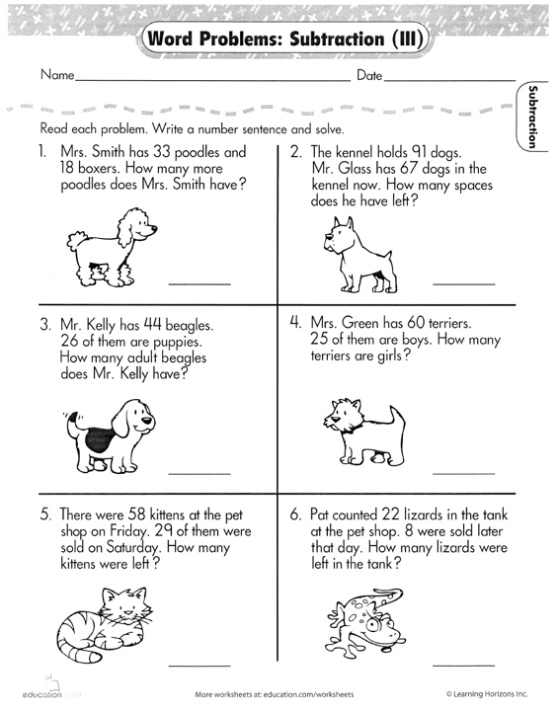

Slide 157
Don’t tie key words to operations
Do have an attack strategy
Do teach word-problem schemas

Slide 158
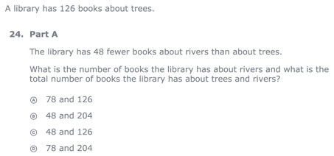
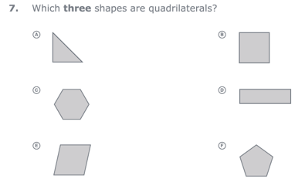
For every word problem
Regardless of problem type, students need an attack strategy for working through the problem
This strategy should work for any problem type
Routine Word Problems
Instructional Word Problems

Slide 159
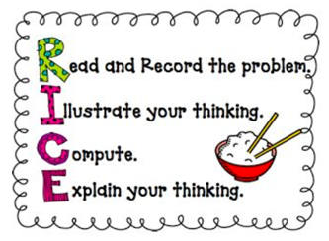
RIDGES
Read the problem.
I know statement.
Draw a picture.
Goal statement.
Equation development.
Solve the equation.
RIDE
Read the problem.
Identify the relevant information.
Determine the operation and unit for the answer.
Enter the correct numbers and calculate, then check the answer.

Slide 160
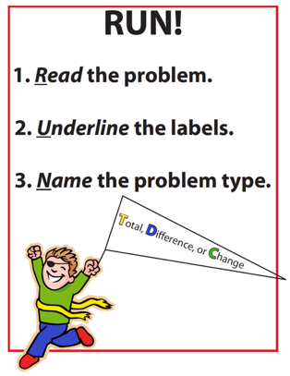
SIGNS
Survey questions
Identify key words
Graphically draw problem
Note operations
Solve and check
SOLVE
Study the problem.
Organize the facts.
Line up the plan.
Verify the plan with computation.
Examine the answer.

Slide 161
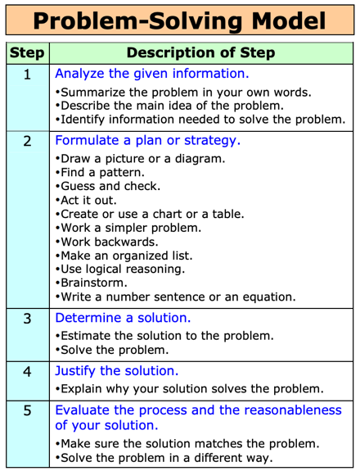
R-CUBES
Read the problem.
Circle key numbers.
Underline the question.
Box action words.
Evaluate steps.
Solve and check.

Slide 163
Don’t tie key words to operations
Do have an attack strategy
Do teach word-problem schemas

Slide 164
Additive Schemas

Slide 165
Instruction Using Schemas
A schema refers to the structure of the word problem
Total
Difference
Change

Slide 166
Total
Parts put together into a total
Autumn saw 4 cardinals and 5 blue jays. How many birds did Autumn see?
4 + 5 = ?
Autumn saw 9 birds. If 4 of the birds were cardinals, how many were blue jays?
4 + ? = 9
Autumn r saw 9 birds. 5 of the birds were blue jays, how many were cardinals?
5 + ? = 9

Slide 167
Total
“Are parts put together for a total?”

Slide 168
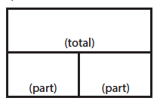
Total
P1 + P2 = T
Fuchs et al. (2008); Griffin & Jitendra (2009)

Slide 169
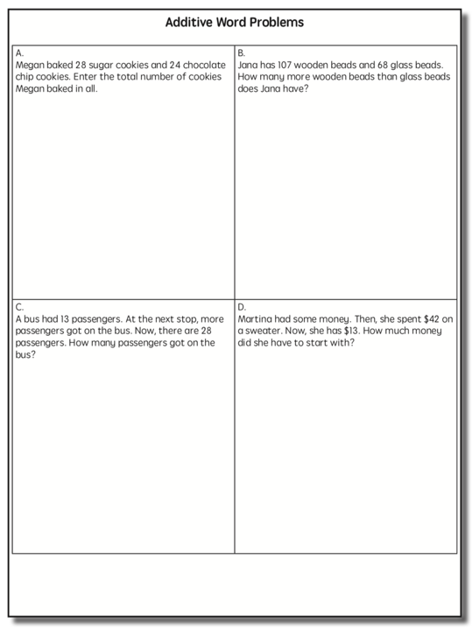
Total

Slide 170
Total
✓
✓
✓
P1 + P2 = T
U
P
S
✓
✓
28
+
24
=
?
✓
✓
28 + 24 = 52
? = 52 cookies
Grade 3 Smarter Balanced

Slide 171
Difference
Greater and less amounts compared for a difference
Lydia has 9 apples. Carol has 4 apples. How many more apples does Lydia have? (How many fewer?)
9 – 4 = ?
Lydia has 5 more apples than Carol. If Carol has 4 apples, how many does Lydia have?
? – 4 = 5
Carol has 5 fewer apples than Lydia. Lydia has 9 apples. How many apples does Carol have?
9 – ? = 5

Slide 172
Total
“Are parts put together for a total?”
Difference
“Are amounts compared for a difference?”

Slide 173
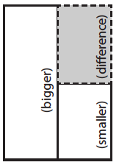
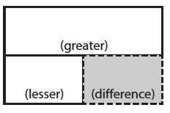
Difference
G – L = D
Fuchs et al. (2008); Griffin & Jitendra (2009)

Slide 174
Difference

Slide 175
Difference
✓
✓
G – L = D
✓
U
P
S
✓
✓
107
-
68
=
B
107
68
68
+ ?
107
✓
107 – 68 = 39
✓
Grade 3 Smarter Balanced
B = 39 more beads

Slide 176
Change
An amount that increases or decreases
Victoria had $4. Then she earned $3 for cleaning her room. How much money does Victoria have now?
4 + 3 = ?
Victoria has $4. Then she earned money for cleaning her room. Now Victoria has $7. How much money did she earn?
4 + ? = 7
Victoria had some money. Then she made $3 for cleaning her room. Now she has $7. How much money did Victoria start with?
? + 3 = 7

Slide 177
Change
An amount that increases or decreases
Julie baked 9 cookies. Then, she ate 2 of the cookies. How many cookies does Julie have now?
9 – 2 = ?
Julie baked 9 cookies. Then, she ate some of the cookies. Now, she has 7 cookies. How many cookies did Julie eat?
9 – ? = 7
Julie baked some cookies. She ate 2 of the cookies and has 7 cookies left. How many cookies did Julie bake?
? – 2 = 7

Slide 178
Total
“Are parts put together for a total?”
Difference
“Are amounts compared for a difference?”
Change
“Does an amount increase or decrease?”

Slide 179
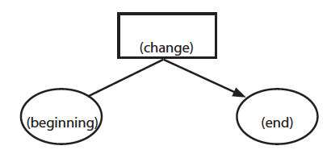
Change
ST +/– C = E
Fuchs et al. (2008); Griffin & Jitendra (2009)

Slide 180
Change

Slide 181
Change
✓
A bus had 13 passengers. At the next stop, more passengers got on the bus. Now, there are 28 passengers. How many passengers got on the bus?
✓
✓
U
P
S
✓
ST + C = E
✓
13
+
?
=
28
✓
28
- 13
✓
13
+ ?
28
13 + 15 = 28
? = 15 passengers

Slide 182
Change

Slide 183
Let’s Review
What’s a Total problem?
What’s a Difference problem?
What’s a Change problem?

Slide 184
Schema Quiz Time!

Slide 185
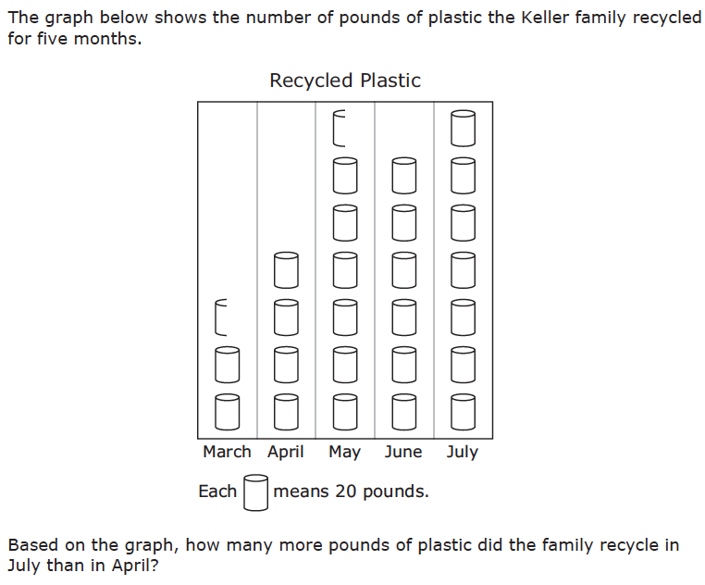
Difference
Grade 3 STAAR

Slide 186
Change
Grade 4 Smarted Balanced

Slide 187
Total
Grade 5 Smarter Balanced

Slide 188
Multiplicative Schemas

Slide 189
Equal Groups
Groups multiplied by number in each group for a product
Scott has 2 bags of apples. There are 6 apples in each bag. How many apples does Scott have altogether?
2 × 6 = ?
Scott has 12 apples. He wants to share them equally among his 2 friends. How many apples will each friend receive?
2 × ? = 12
Scott has 12 apples. He put them into bags containing 6 apples each. How many bags did Scott use?
? × 6 = 12

Slide 190
Equal Groups
“Are there groups with an equal number in each group?”

Slide 191
Equal Groups
G × N = P

Slide 192
Equal Groups

Slide 193
Equal Groups
✓
✓
✓
G x N = P
U
P
S
✓
✓
x
=
6
25
?
✓
✓
6 x 25 = 150
? = 150 cherries

Slide 194
Equal Groups

Slide 195
Comparison
Set multiplied by a number of times for a product
Julie picked 6 apples. Amy picked 2 times as many apples as Marcie. How many apples did Lisa pick?
6 × 2 = ?
Amy picked 12 apples. She picked 2 times as many apples as Julie. How many apples did Julie pick?
? × 2 = 12
Amy picked 12 apples, and Julie picked 6 apples. How many times as many apples did Amy pick?
6 × ? = 12

Slide 196
Equal Groups
“Are there groups with an equal number in each group?”
Comparison
“Is a set compared a number of times?”

Slide 197
Comparison
S × T = P

Slide 198
Comparison

Slide 199
Comparison
✓
U
P
S
✓
18
3
?
✓
✓
✓
Grade 4 Smarter Balanced
? = 54 books

Slide 200
Ratios/Proportions
Description of relationships among quantities
Xin et al. (2005)

Slide 201
Equal Groups
“Are there groups with an equal number in each group?”
Comparison
“Is a set compared a number of times?”
Ratios/Proportions
“Are there relationships among quantities - if this, then this?”

Slide 202
Ratios/Proportions

Slide 203
Ratios/Proportions
✓
✓
✓
✓
U
P
S
✓
✓
176
?
? = 110 slices
✓
✓
8
5

Slide 204
Let’s Review
What’s an Equal Groups problem?
What’s a Comparison problem?
What’s a Ratios/Proportions problem?

Slide 205
Schema Quiz Time!

Slide 206
Ratios/Proportions
Grade 6 Smarter Balanced

Slide 207
Equal Groups
Grade 4 PARCC

Slide 208
Comparison
Grade 4 Smarter Balanced

Slide 209
Schemas
Total
Difference
Change
Equal Groups
Comparison
Ratios/Proportions

Slide 210
Don’t tie key words to operations
Do have an attack strategy
Do teach word-problem schemas

Slide 211
How do you teach problem solving?
Don’t use key words tied to operations
Do teach students an attack strategy
Do teach students schemas

Slide 212
Instructional Platform
INSTRUCTIONAL DELIVERY
Explicit instruction
Precise language
Multiple representations
INSTRUCTIONAL STRATEGIES
Fluency building
Problem solving instruction

Slide 213
https://intensiveintervention.org/intensive-intervention-math-course

Slide 214
https://www.amazon.com/Teaching-Math-Middle-School-Students/dp/1598572741

Slide 215
srpowell@austin.utexas.edu
@sarahpowellphd
119

